Slide 1

Implementation of Image Encryption and Decryption in Verilog
DEPARTMENT OF ECE
UEC1811-PROJECT WORK
Domain – Very Large Scale Integration(VLSI)
GUIDED BY
Mr. R. Balamurugan ME.,(Ph.D),
Assistant professor,
Department of ECE,
K.Ramakrishnan College Of Engineering.
TEAM MEMBERS
Narmatha M – 8115U20EC063
Nisha V R - 8115U20EC067
Pooja R - 8115U20EC070

Slide 2
CONTENTS
ABSTRACT
INTRODUCTION
LITERATURE SURVEY
EXISTING SYSTEM
CHALLENGES IN EXISTING SYSTEM
PROPOSED SYSTEM
SOFTWARE REQUIREMENT
MODULE DESCRIPTION
CONCLUSION
FUTURE SCOPE
REFERENCES

Slide 3
ABSTRACT
In this project, proposes an image encryption and decryption modules based on the Advanced Encryption Standard (AES) and Data Encryption Standard (DES) algorithms in128-bit keys using Python and Xilinx.
Block cipher modes of operation such as Electronic Codebook (ECB), Cipher Block Chaining (CBC), Cipher Feedback (CFB), and Output Feedback (OFB) to improve security and enable the encryption of arbitrary-sized images.
In order to improve data security and optimize the rate of time we created verilog code to implement 128 bits of AES and DES for image encryption and decryption that is synthesized and simulated USING XILINX TOOL. We achieved the Maximum Frequency 100MHz and the power consumption rate is 28007.343nw

Slide 4
INTRODUCTION
Encryption
Encryption is the process of converting readable data (plaintext) into an unreadable format (ciphertext) using a cryptographic key.
This ensures that only authorized parties with the correct key can decode the ciphertext back into plaintext, protecting the information from unauthorized access.
Decryption
Decryption is the process of converting encrypted data (ciphertext) back into its original form (plaintext) using a secret key or password.
It ensures that only authorized users can access the information, protecting it from unauthorized access and maintaining privacy during data transmission.

Slide 5
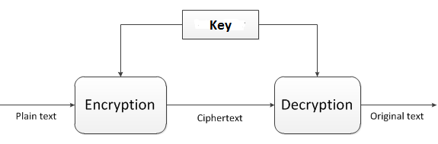
Block diagram for encryption and decryption

Slide 6
MAIN TYPES OF ENCRYPTION METHEDOLOGIES
There are 2 main types of encryption methodologies:
Symmetric Encryption
In symmetric encryption, the same secret key is used for both encryption and decryption,
shared between the sender and receiver. It must remain confidential for security.
This method is faster and more efficient than asymmetric encryption.
Common symmetric algorithms include AES and DES.
Asymmetric Encryption
In asymmetric encryption, or public-key encryption, a public key is used for encryption and a private key for decryption. The public key can be freely distributed, enabling anyone to encrypt data that only the private key holder can decrypt.
It is slower but offers additional security benefits like secure key distribution and non-repudiation. Common asymmetric encryption algorithms include RSA and ECC.

Slide 7
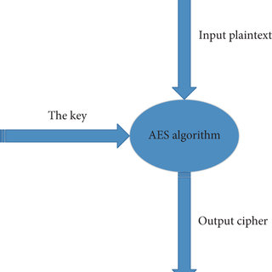
AES (Advanced Encryption Standard)
AES is a widely used symmetric encryption algorithm that supports key lengths of 128, 192, and 256 bits.
It is commonly used in various applications, including secure communication, data storage and encrypt of sensitive information.

Slide 8
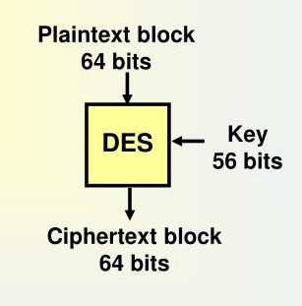
DES (Data Encryption Standard)
DES is a symmetric-key block cipher that encrypts data in 64-bit blocks using a 56-bit key.
It uses a Feistel network structure with multiple rounds of encryption and a complex key schedule. Despite its historical significance, DES is now considered insecure for practical use due to its small key size.

Slide 9
LITERATURE SURVEY
S.NO | JOURNAL TITLE | AUTHORS | YEAR | DISCUSSIONS
1 | AES Based Algorithm for Image Encryption and Decryption | Prof. Venkatesha G Dr. Dinesh S Dr. Manjunath M | 2020 | The paper implements AES for image encryption, focusing on secure data transmission. 2. It describes the AES 128-bit Verilog synthesis on FPGA, showcasing its efficiency in encryption.
2 | Image Encryption and Decryption using AES Algorithm | Roshni Padate, Aamna Patel | 2020 | The paper recommends AES over DES for image security due to AES's higher encryption quality and real-time efficiency. 2. AES is favored over DES in the paper for image security, as it offers superior encryption quality and real-time encryption performance.
3 | Review on Image Encryption/Decryption using AES Algorithm for Hardware Accelerator Design and Implementation | Deeksha P1 , Suchitra M2 , Mokshith B3 , Sharath Kumar K4 , Ayaz Jaffar5 | 2020 | 1. The paper explores AES for hardware-accelerated image encryption, proposing a hybrid approach and discussing challenges like permutation and steganography. 2. It aims to enhance image privacy through improved encryption techniques and hardware acceleration, highlighting the benefits of the AES algorithm.

Slide 10
CONT…..
S.NO | JOURNAL TITLE | AUTHOR | YEAR | DISCUSSIONS
4 | Implementation of AES Algorithm Using Verilog | Ganesh Gopal Shet , Jamuna V, Shravani S, Nayana H G, Pramod Kumar S | 2020 | 1.Cryptography is crucial for data security, especially with the rise of e-commerce and internet applications, making AES encryption in Verilog essential. 2. AES, with key lengths of 128, 192, and 256 bits, is implemented to protect electronics data, reducing encryption delay through parallel design.
5 | Analysis of AES and DES Algorithm | Elhadi Kenane, Messaoud Garah, Fadila Benmeddour | 2020 | Cryptography encodes data for secure transmission; AES and DES are popular algorithms studied here for efficiency and security parameters. 2. The paper explores cryptographic algorithms like AES and DES, analyzing their efficiency based on time, bit independence, and avalanche effect.
6 | Implementation of Data Encryption Standard algorithm using Verilog | Ashwini.R.Patil , Pramod Patil , Rajeshwari. Khot, Laxmi Patil, Anusha Fernandes | 2018 | 1. DES is a symmetric key algorithm encrypting data in 64-bit blocks using a 56-bit key, employing substitution and permutation techniques. 2. It encrypts and decrypts using the same key, processing data in 64-bit blocks with a 56-bit key length.

Slide 11
CONT…..
S.NO | JOURNAL NAME | AUTHORS | YEAR | DISCUSSIONS
7 | Image Encryption and Decryption using AES | Manoj. B, Manjula N Harihar | 2019 | 1. The document implements AES for image encryption and decryption in communication systems, highlighting its efficiency in software and hardware. 2. It emphasizes data security, detailing AES's symmetric cryptography in rounds, with FPGA implementation using VHDL.
8 | FPGA Implementation of AES for Image Encryption and Decryption | Vijayakumar P, Chaitanya Kumar Chittoju, A.V.Bharadwaja, Payal P. Tayade, Tamilselvi M, R.Rajashree, Xiao-Zhi Gao | 2019 | 1. The document examines FPGA implementation of AES for 128-bit image encryption, with a proposed S-Box structure. 2. It involves MATLAB for image data conversion, simulation with Model Sim-Altera 6.4a and Xilinx ISE, focusing on FPGA-based AES encryption.
9 | 2D Image Encryption and Decryption using AES algorithm in spartan – 3E FPGA | handrasekhar V1 , Ravi Babu T2 , PSN Bhaskar3 , Nihar Ranjan Panda4 | 2019 | 1.The paper implements AES 128-bit core on Spartan-3E FPGA for 2D image encryption, utilizing UART for data transfer. 2. It discusses AES specifics, FPGA blocks, and performance analysis, offering secure data transmission solutions for different sectors.

Slide 12
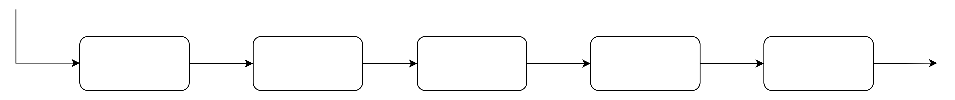
EXISTING SYSTEM
IMAGE
decrypted data
Read the image
MATLAB
AES CORE
FPGA
KEYBOARD
MATLAB
ORIGINAL IMAGE
1024^1024
encryption
& decryption in Verilog code
supports for both hardware and software system
used to input the key that is symmetric key.
symmetric key(secret key), same key used in both transmitter and receiver side.
When key matches at the receiver side the output can be on FPGA and these values are displayed on LCD.

Slide 13
CHALLENGES IN EXISTING SYSTEM
The challenges are :
Ensuring the security of digital images during transmission and storage to protect important data and image communication.
Preventing unauthorized access to confidential image data through effective encryption and decryption methods.
Developing Verilog code to implement AES for image encryption and decryption.
Synthesizing and simulating the AES algorithm on the FPGA family of Spartan-6 using Xilinx ISE 12.4 tool.
Achieving a high maximum frequency of 165.462MHz and a throughput of 252.132Mbit/sec for image encryption and decryption.
Ensuring that the implementation is secure against side-channel attacks and other vulnerabilities is
critical for cryptographic algorithms like AES and DES.

Slide 14
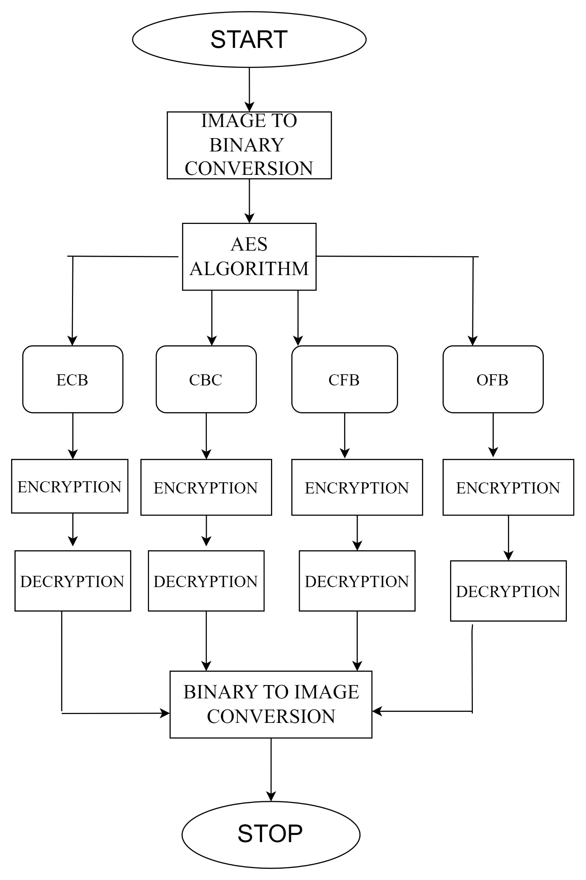
PROPOSED SYSTEM

Slide 15
SOFTWARE REQUIRED
XILINX ISE TOOL 14.7
PYTHON

Slide 16
MODULE DESCRIPTION
MODULE 1 - INPUT IMAGE
MODULE 2 – AES CORE ALGORITHM
MODULE 3 - ELECTRONIC CODE BOOK MODE (ECB)
MODULE 4- CIPHER BLOCK CHAINING MODE (CBC)
MODULE 5 - CIPHER FEEDBACK MODE (CFB)
MODULE 6 - OUTPUT FEEDBACK MODE (OFB)
MODULE 7 - OUTPUT IMAGE

Slide 17

INPUT IMAGE
MODULE 1:
The input image is in the form of 1024^1024 gray scale image
Each image pixel value between 0 to 255 both encryption and decryption scheme for modes of operation on Advanced Encryption Standard Algorithm.
Using python NUMPY and CV2 package to convert the (fig 2.) into the Binary text and vice versa.

Slide 18
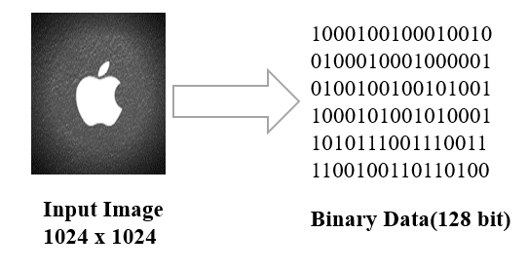
CONT….

Slide 19
What is the Advanced Encryption Standard?
MODULE 2:
Symmetric Block Cipher
Known as the Rijndael algorithm.
Block size: 128 bits.
Key sizes: 128, 192, and 256 bits.
Process:
Encrypts data in 128-bit blocks.
Joins encrypted blocks to form ciphertext.
Structure:
Based on a Substitution-Permutation Network (SP network).
Substitutions: Replace inputs with specific outputs.
Permutations: Bit shuffling operations.

Slide 20
What are the Features of AES?
SP Network: It works on an SP network structure rather than a Feistel cipher structure, as seen in the case of the DES algorithm.
Key Expansion: It takes a single key up during the first stage, which is later expanded to multiple keys used in individual rounds.
Byte Data: The AES encryption algorithm does operations on byte data instead of bit data. So it treats the 128-bit block size as 16 bytes during the encryption procedure.
Key Length: The number of rounds to be carried out depends on the length of the key being used to encrypt data. The 128-bit key size has ten rounds, the 192-bit key size has 12 rounds, and the 256-bit key size has 14 rounds.

Slide 21
Data Transmission:
AES operates on a 4x4 matrix (state array) where each cell holds 1 byte (16 bytes total per block).
State Array:
The 4x4 matrix holds the data for a single 128-bit block.
Key Expansion:
Initial key is expanded into multiple round keys.
For a 128-bit key: 10 rounds + 1 initial key = 11 keys total.
Round Keys:
Used in each step of the encryption process.
How Does AES Work?

Slide 22
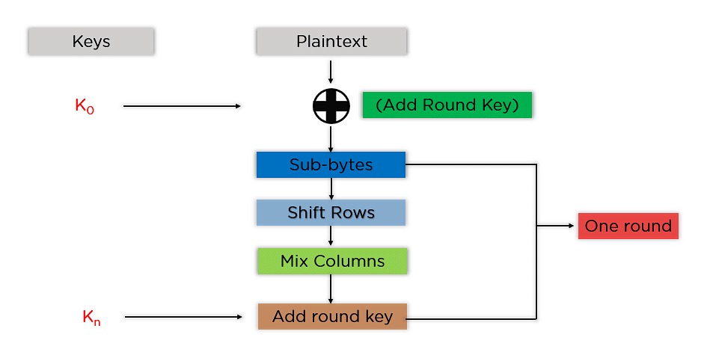
STEPS TO BE FOLLOWED IN AES

Slide 23
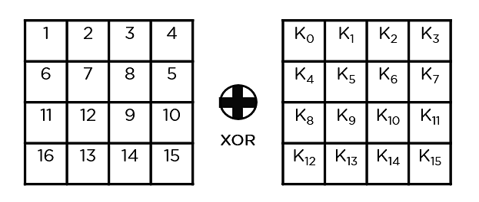
CONT….
The mentioned steps are followed for each block sequentially, and the encrypted blocks are combined to form the final ciphertext. Steps include SubBytes, ShiftRows, MixColumns, and Add Round Key.
Add Round Key: You pass the block data stored in the state array through an XOR function with the first key generated (K0). It passes the resultant state array on as input to the next step.

Slide 24
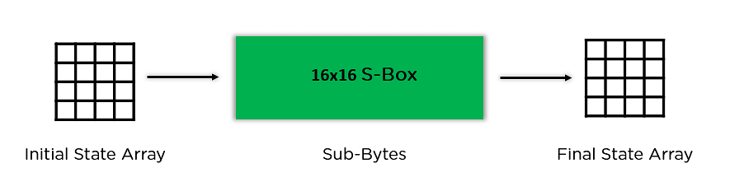
CONT….
Sub-Bytes: In this step, it converts each byte of the state array into hexadecimal, divided into two equal parts. These parts are the rows and columns, mapped with a substitution box (S-Box) to generate new values for the final state array.

Slide 25
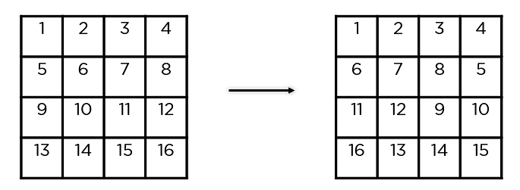
CONT….
Shift Rows: It swaps the row elements among each other. It skips the first row. It shifts the elements in the second row, one position to the left. It also shifts the elements from the third row two consecutive positions to the left, and it shifts the last row three positions to the left.

Slide 26
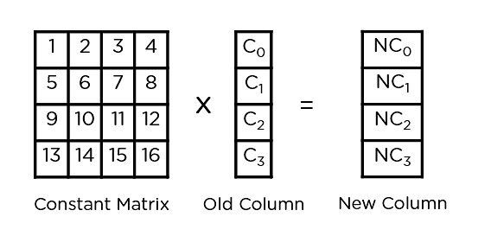
CONT….
Mix Columns: It multiplies a constant matrix with each column in the state array to get a new column for the subsequent state array. Once all the columns are multiplied with the same constant matrix, you get your state array for the next step. This particular step is not to be done in the last round.

Slide 27
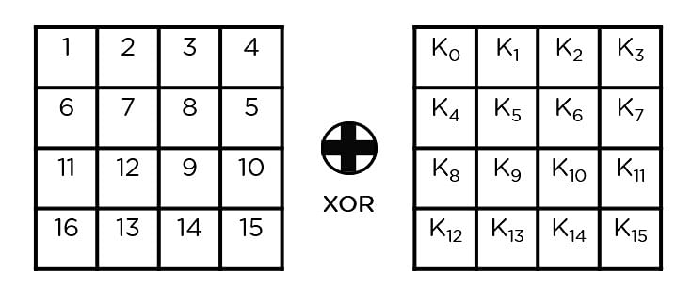
CONT….
Add Round Key: The respective key for the round is XOR ’ d with the state array is obtained in the previous step. If this is the last round, the resultant state array becomes the ciphertext for the specific block; else, it passes as the new state array input for the next round.

Slide 28
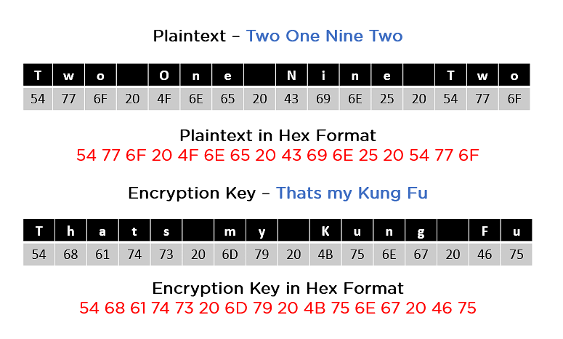
CONT….
Now that you grasp the fundamental steps of the encryption process, consider this example to follow along.

Slide 29
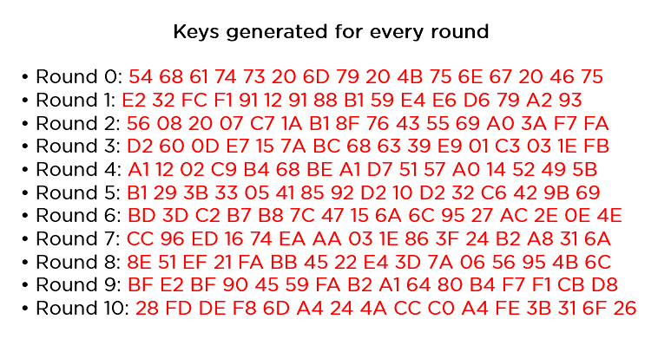
CONT….
In the image above, both the plaintext and encryption keys are converted to hex format before beginning the operations. You can then generate the keys for the next ten rounds, as shown below.

Slide 30
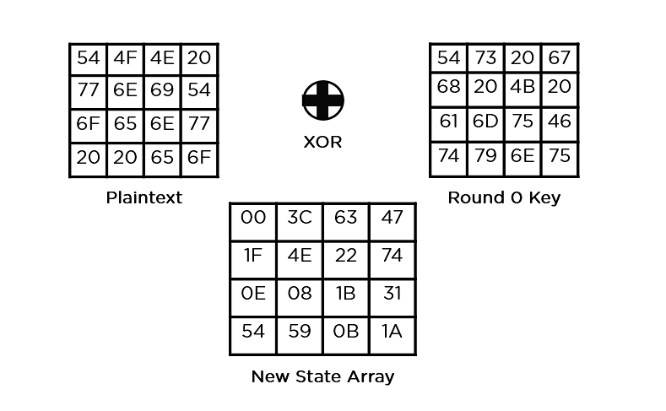
CONT….
Follow the same steps as explained above, sequentially extracting the state array and using it as input for the next round. The steps are as follows:
Add Round Key:

Slide 31
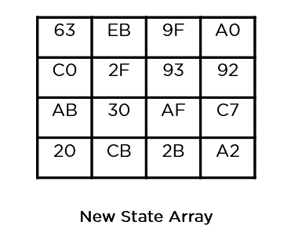
CONT….
Sub-Bytes: It passes the elements through a 16x16 S-Box to get a completely new state array.

Slide 32
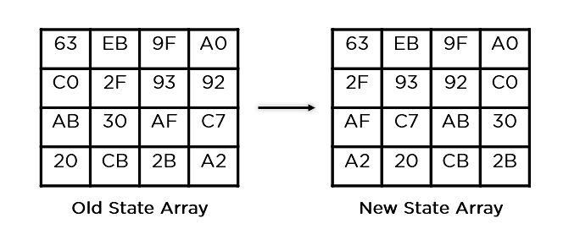
CONT….
Shift Rows:

Slide 33
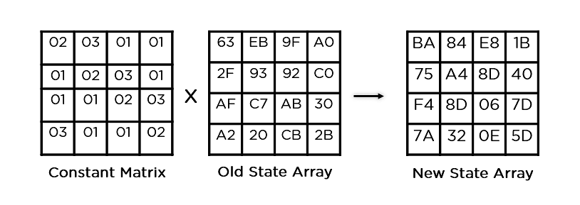
CONT….
Mix Columns:

Slide 34
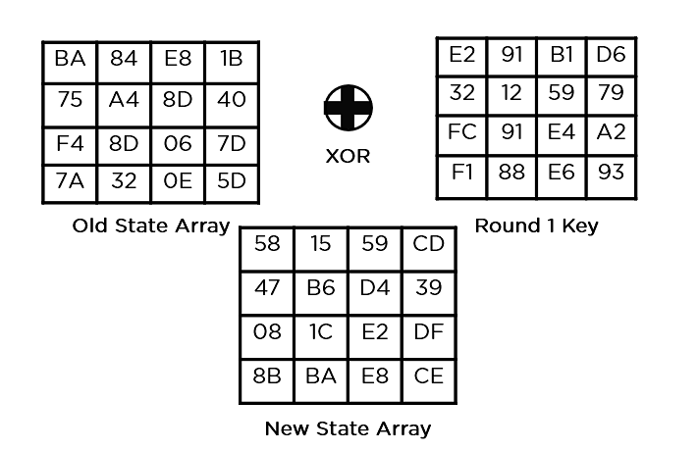
CONT….
Add Round Key:

Slide 35
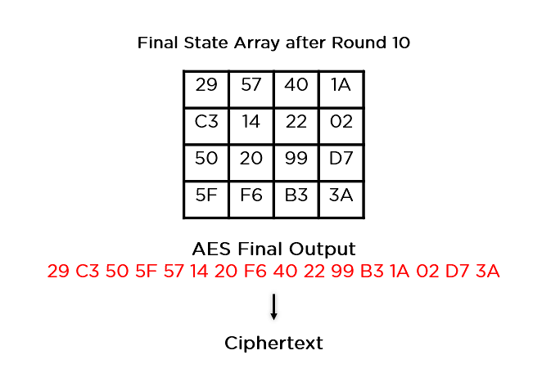
CONT….
This state array is now the final ciphertext for this particular round. This becomes the input for the next round. Depending on the key length, you repeat the above steps until you complete round 10, after which you receive the final ciphertext.

Slide 36
CONT….
Applications of AES:
Wireless Security: Used in WiFi networks for authentication.
Encrypted Browsing: Ensures secure SSL/TLS encryption for website communication.
General File Encryption: Encrypts files for secure transfer
Processor Security: Some processors use AES for hardware-level encryption.

Slide 37
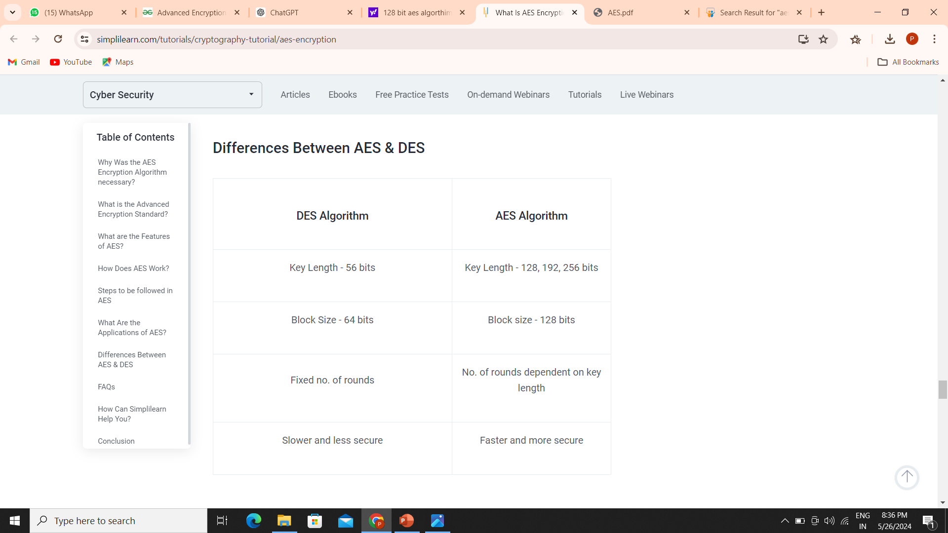
CONT….
Differences Between AES & DES
AES is a more secure and efficient encryption standard compared to DES. AES provides better protection against attacks and is widely used in various applications where data security is paramount.

Slide 38
ELECTRONIC CODE BOOK MODE (ECB)
MODULE 3:
It is easier because of direct encryption of each block of input plaintext and output is in form of blocks of encrypted ciphertext.
Generally, if a message is larger than b bits in size, it can be broken down into a bunch of blocks and the procedure is repeated.
Advantages of ECB
Parallel encryption of blocks of bits is possible, thus it is a faster way of encryption.
Disadvantages of ECB
Prone to cryptanalysis since there is a direct relationship between plaintext and ciphertext.

Slide 39
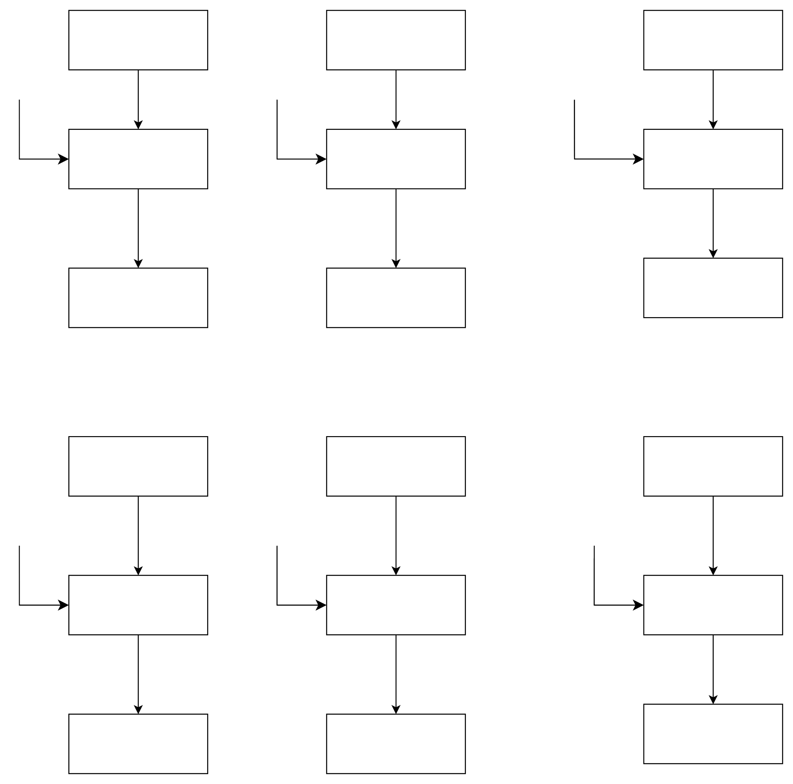
Block Diagram for Electronic code book mode
Encryption:
P1
P2
………
Pn
K
K
K
ENCRYPTION
ENCRYPTION
ENCRYP
TION
K- KEY
P-PLAIN TEXT
C-CIPHER TEXT
C2
C2
………
Cn
Decryption:
C1
C2
………
Cn
K
K
K
DECRYPTION
DECRYP
TION
DECRYP
TION
P1
P2
………
Pn

Slide 40

ENCRYPTED IMAGE:
DECRYPTED IMAGE:
1024 x 1024

Slide 41
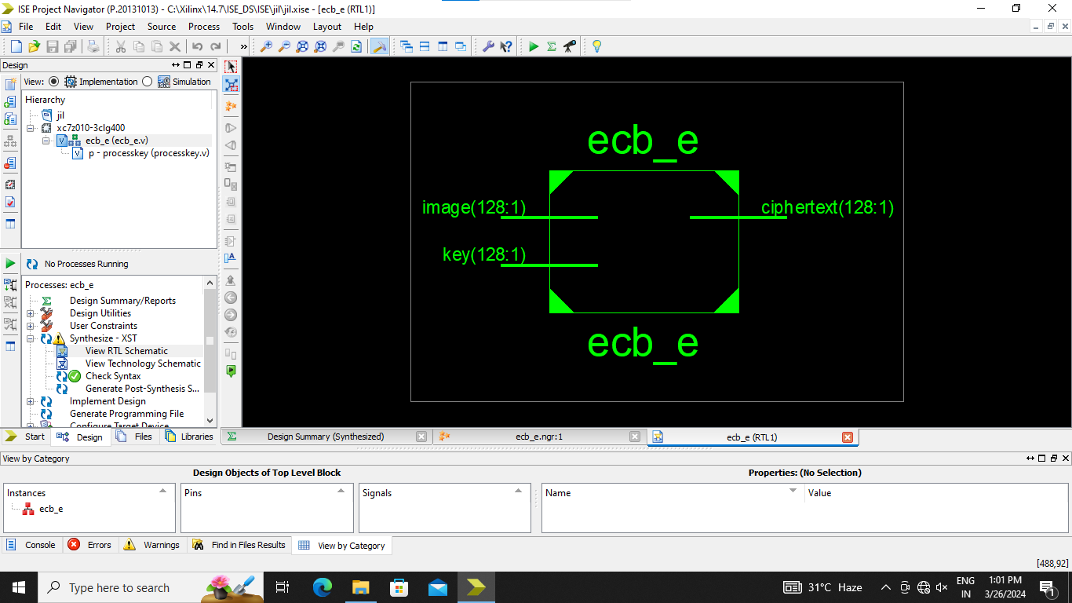
RTL SCHEMATIC DIAGRAM FOR ENCRYPTION

Slide 42
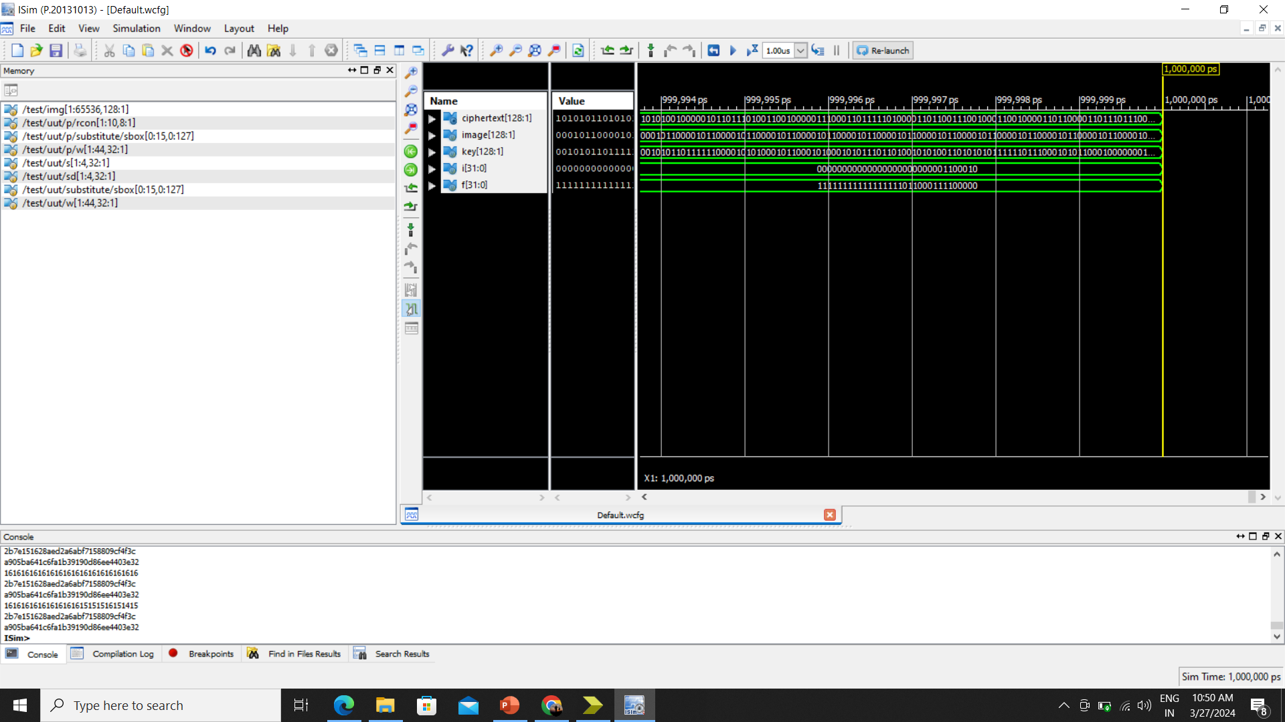
Electronic Code book Mode (ECB) - Encryption SIMULATION

Slide 43
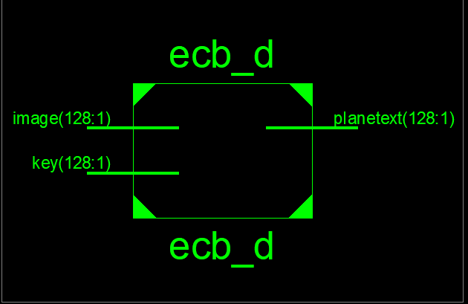
RTL SCHEMATIC DIAGRAM FOR DECRYPTION

Slide 44

Electronic Code book Mode (ECB) - Decryption SIMULATION

Slide 45
CIPHER BLOCK CHAINING MODE (CBC)
MODULE 4:
In CBC, the previous cipher block is given as input to the next encryption algorithm after XOR with the original plaintext block.
In a nutshell here, a cipher block is produced by encrypting an XOR output of the previous cipher block and present plaintext block.
Advantages of CBC
CBC works well for input greater than b bits.
Good authentication mechanism.
Better resistive nature towards cryptanalysis than ECB.
Disadvantages of CBC
Parallel encryption is not possible since every encryption requires a previous cipher

Slide 46
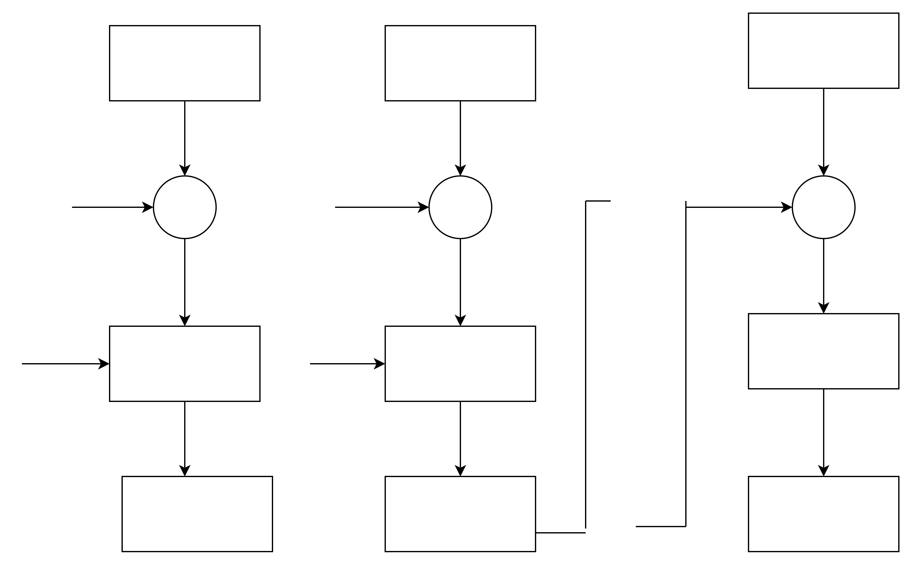
Block Diagram For Cipher Block Chaining Mode
P1
Pn
P2
…….
Initialisation Vector- (IV)
Plain text – P
Key – k
Cipher text - C
IV
+
+
+
K
K
K
Encryption
Encryption
Encryption
……
C1
C2
Cn

Slide 47

ENCRYPTED IMAGE
DECRYPTED IMAGE
1024 x 1024

Slide 48
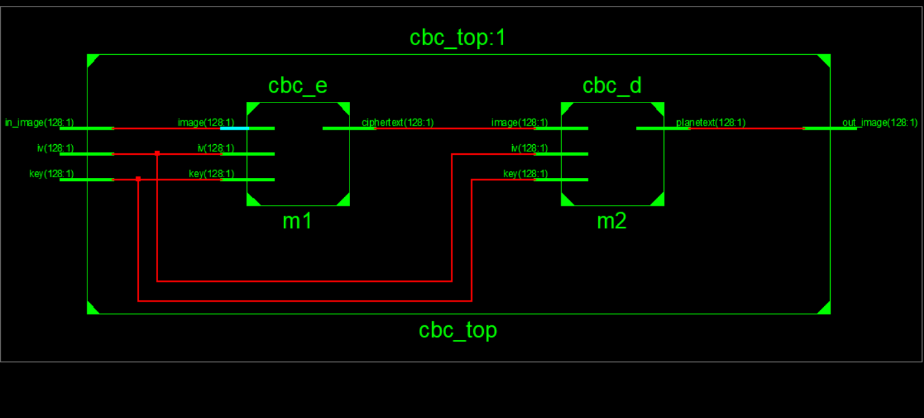
RTL SCHEMATIC DIAGRAM FOR ENCRYPTION AND DECRYPTION

Slide 49
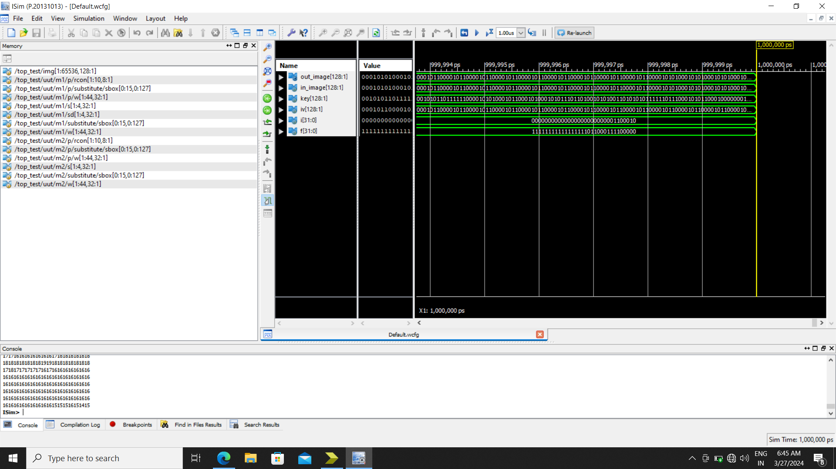
CIPHER BLOCK CHAINING MODE (CBC)-Encryption and Decryption SIMULATION

Slide 50
CIPHER FEEDBACK MODE (CFB)
MODULE 5:
In this cipher feedback (CFB) mode, an initial vector (IV) is used for the first encryption. Output bits are divided into sets of 's' and 'b-s' bits.
's' bits are XORed with plaintext, then inputted into a shift register. Encryption and decryption follow similar procedures using encryption algorithms.
Advantages of CFB
Since, there is some data loss due to the use of shift register, thus it is difficult for applying cryptanalysis.
Disadvantages of using CFB
lacking block loss support and concurrent encryption, but allows loss-tolerant, parallelizable decryption..

Slide 51
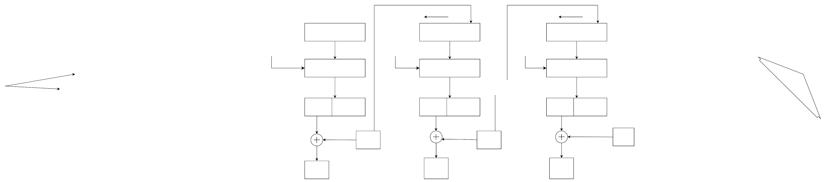
Block Diagram For Cipher Feedback Mode
IV
Shift register
b-s bits s bits
Shift register
b-s bits s bits
Initialisation Vector- (IV)
Plain text – P
Key – k
Cipher text – C
……..
K
Encryption
K
Encryption
K
Encryption
s bits
b-s bits
s
bits
b-s bits
…….
s
bits
b-s
bits
C1
C2
Cn
P1
P2
Pn
Encryption and Decryption

Slide 52


ENCRYPTED IMAGE
DECRYPTED IMAGE
1024 x 1024

Slide 53
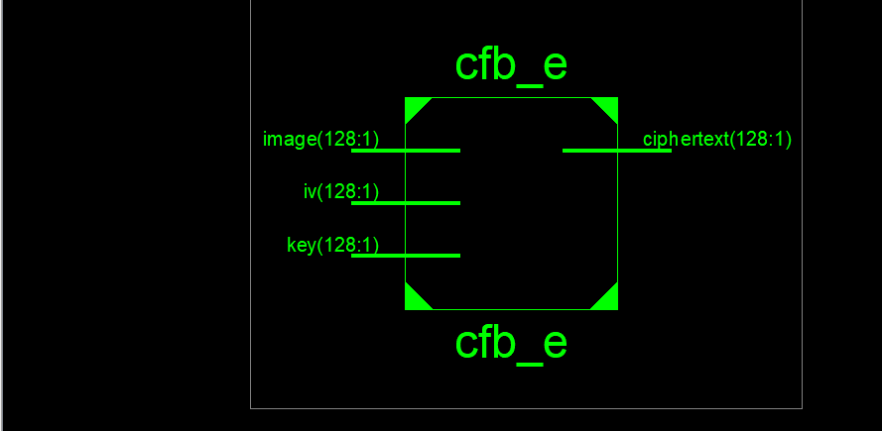
RTL SCHEMATIC DIAGRAM FOR ENCRYPTION

Slide 54
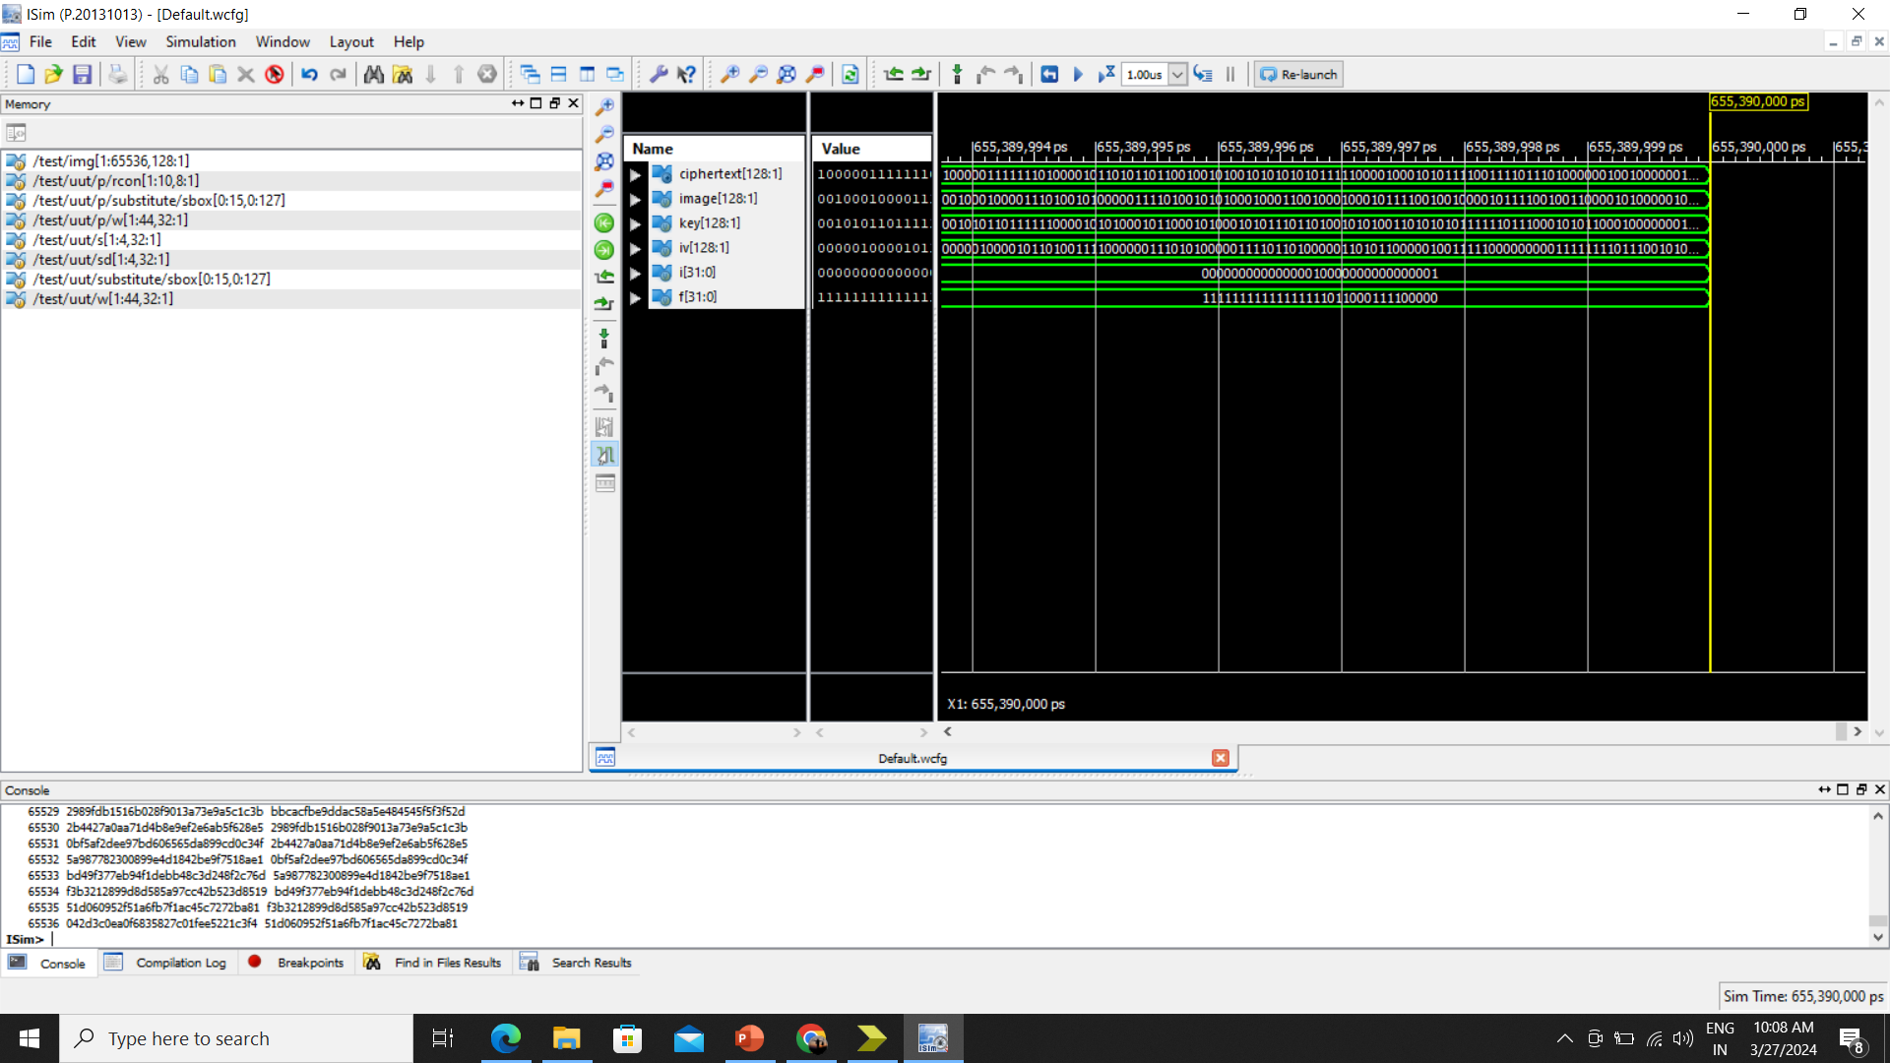
CIPHER FEEDBACK MODE (CFB) - Encryption SIMULATION

Slide 55
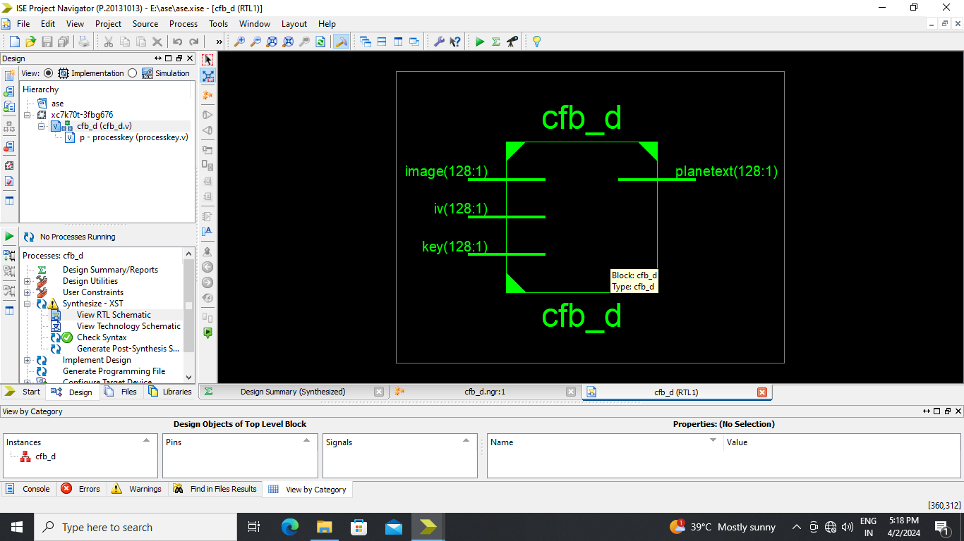
RTL SCHEMATIC DIAGRAM FOR DECRYPTION

Slide 56

CIPHER FEEDBACK MODE (CFB) - Decryption SIMULATION

Slide 57
OUTPUT FEEDBACK MODE (OFB)
MODULE 6:
Output Feedback Mode (OFB) operates similarly to Cipher Feedback Mode (CFB) but transmits encrypted output rather than the cipher itself.
Unlike CFB, it sends all block bits, enhancing error resistance and reducing cipher dependency on plaintext, offering robust transmission and security.
Advantages of OFB
OFB prevents error propagation unlike CFB, ensuring plaintext block integrity.
Disadvantages of OFB
The drawback of OFB is that, because to its operational modes, it is more susceptible to a message stream modification attack than CFB.

Slide 58
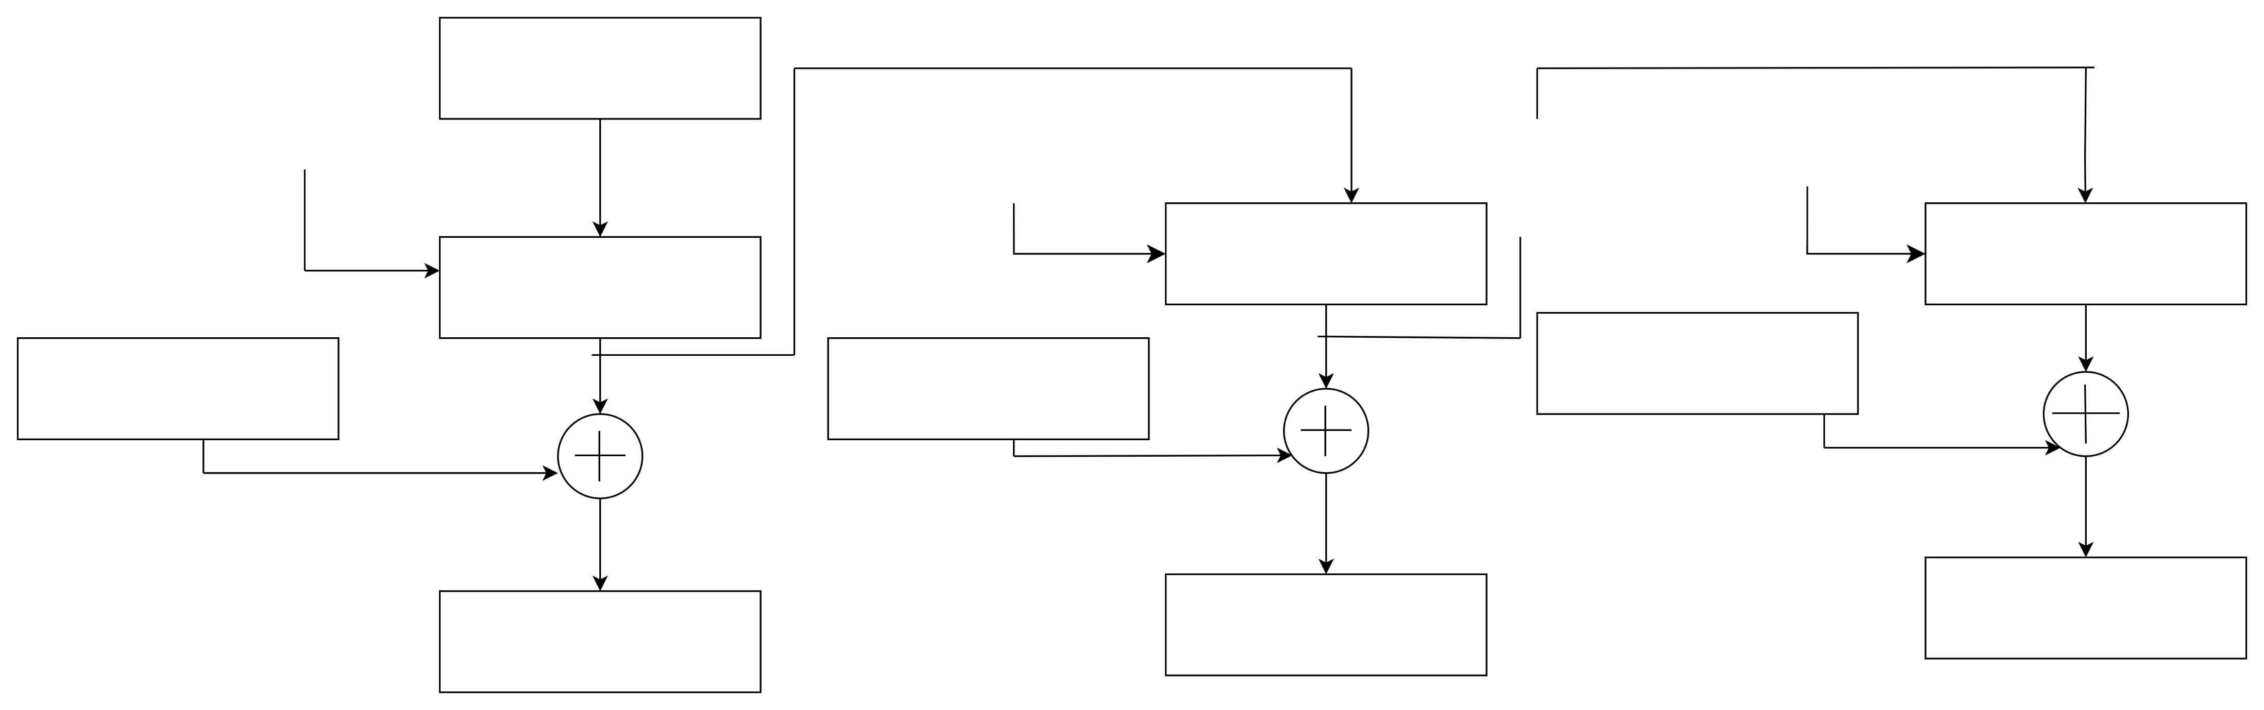
Block Diagram For Output Feedback Mode
Encryption and Decryption
IV
K
K
……..
K
Encryption
Encryption
Encryption
P1
P2
Pn
C1
C2
…….
Cn
Initialisation Vector- (IV)
Plain text – P
Key – k
Cipher text – C

Slide 59

ENCRYPTED IMAGE
DECRYPTED IMAGE
1024 x 1024

Slide 60
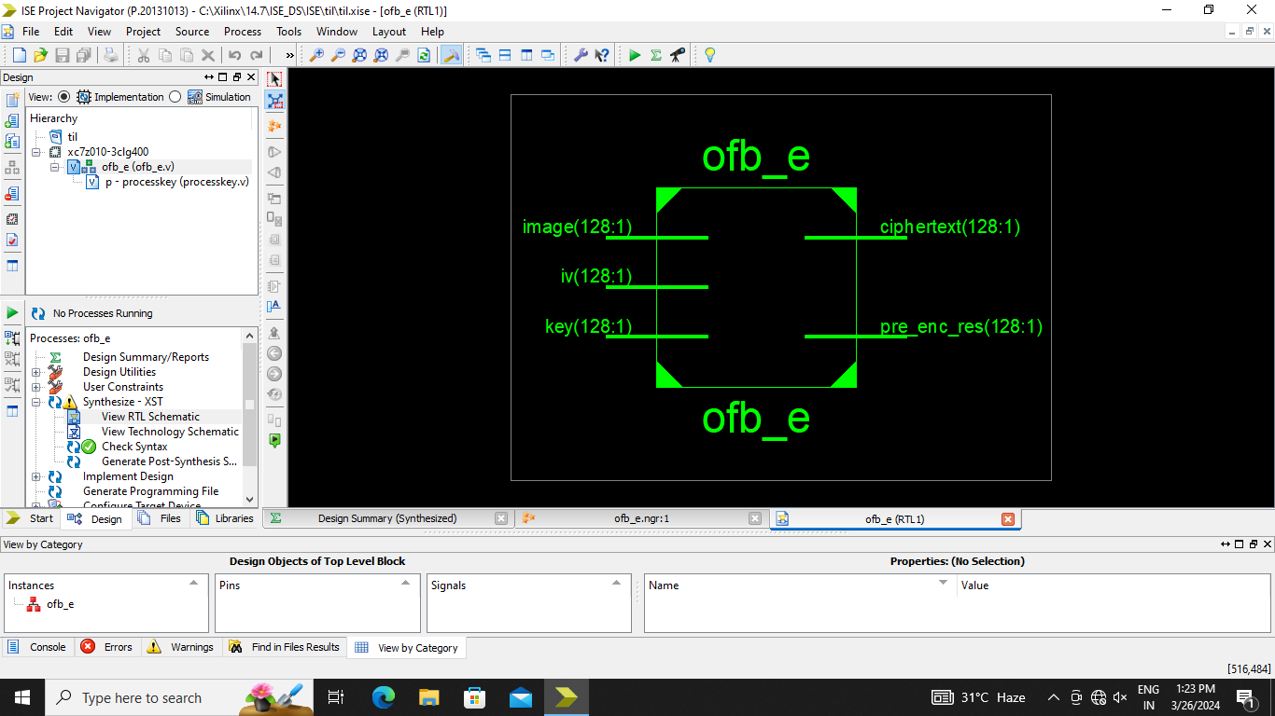
RTL SCHEMATIC DIAGRAM FOR ENCRYPTION

Slide 61
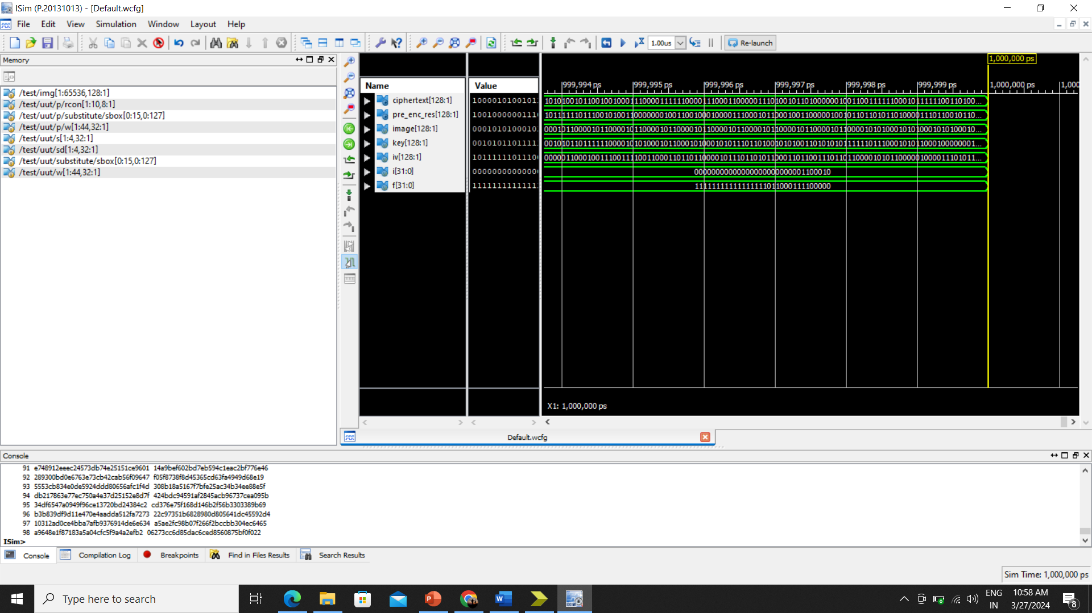
OUTPUT FEEDBACK MODE (OFB)- Encryption SIMULATION

Slide 62

RTL SCHEMATIC DIAGRAM FOR DECRYPTION

Slide 63

OUTPUT FEEDBACK MODE (OFB)- Decryption SIMULATION

Slide 64
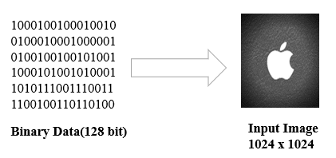
OUTPUT IMAGE
MODULE : 7

Slide 65
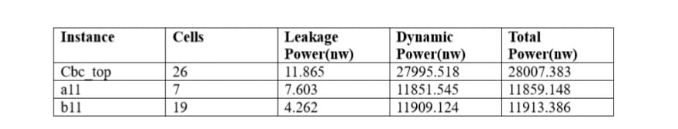
DESIGN SUMMARY
1.POWER
Explore AES and DES algorithms power consumption.
Focus on resource-constrained environments (mobile, IoT).
Minimize energy usage.
Study algorithmic complexities.
Analyze implementation strategies.
The existing system consumed the total power as 28117.452nw And the proposed system consumed the total power as 28007.383.MHz.

Slide 66
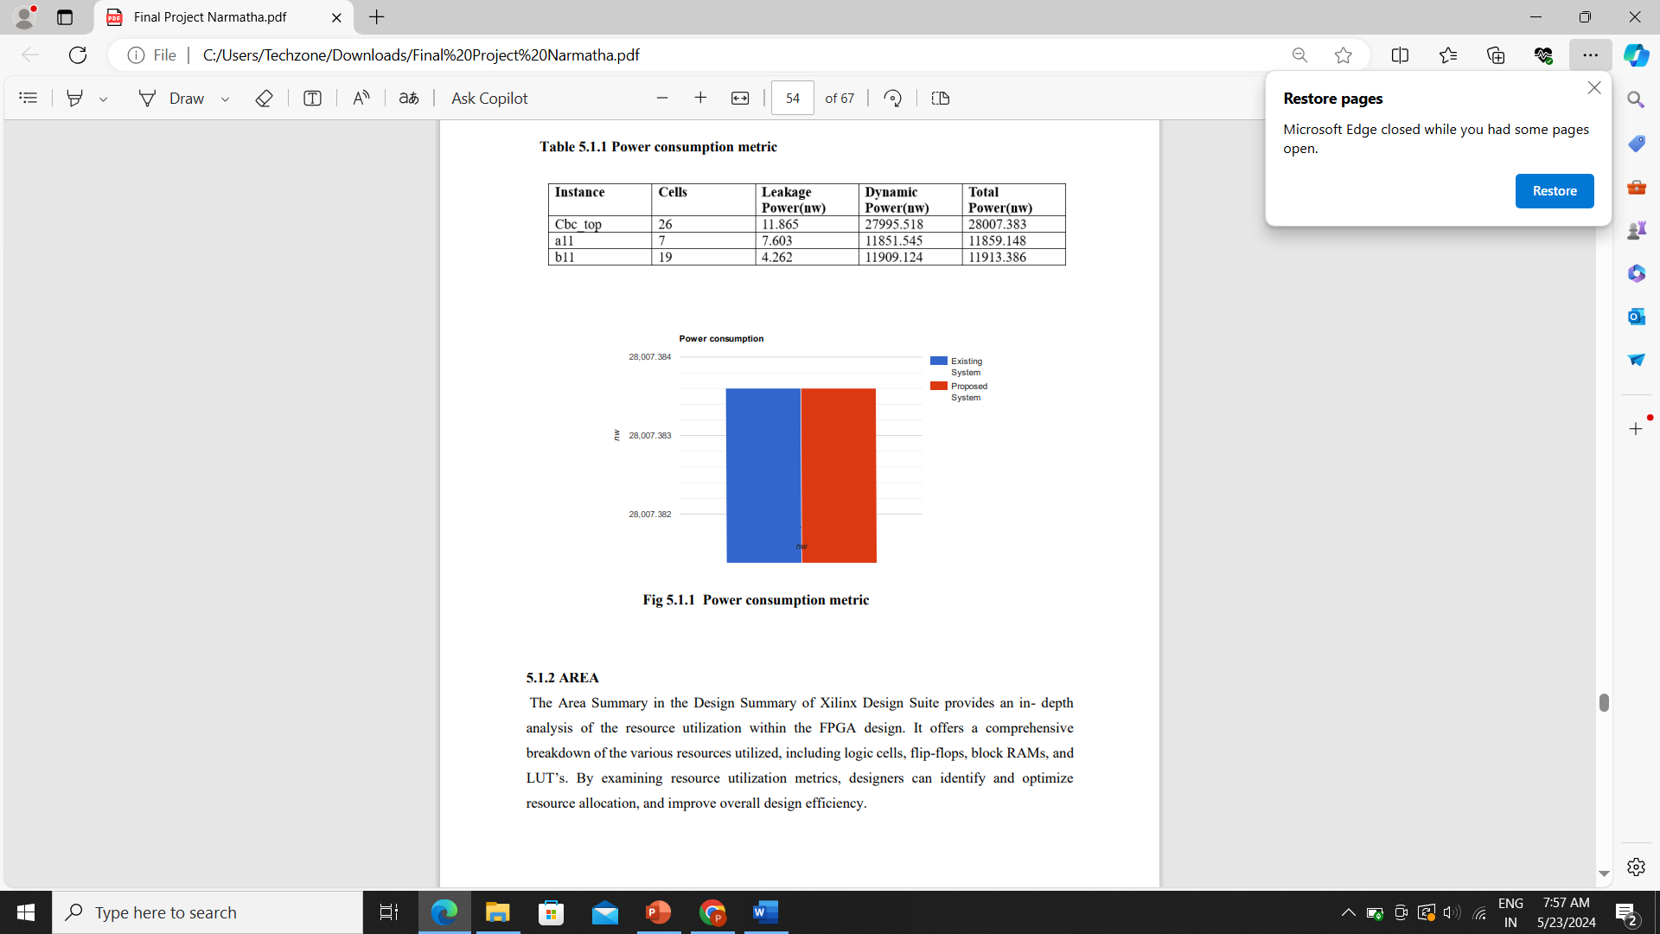
Power consumption metric

Slide 67
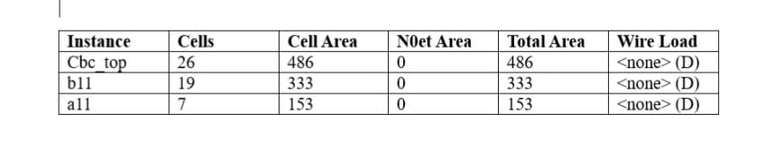
2.AREA
Area Summary in Xilinx Design Suite.
In-depth FPGA resource utilization analysis.
Breakdown of logic cells, flip-flops, block RAMs, LUTs.
Optimize resource allocation.
Improve design efficiency.

Slide 68
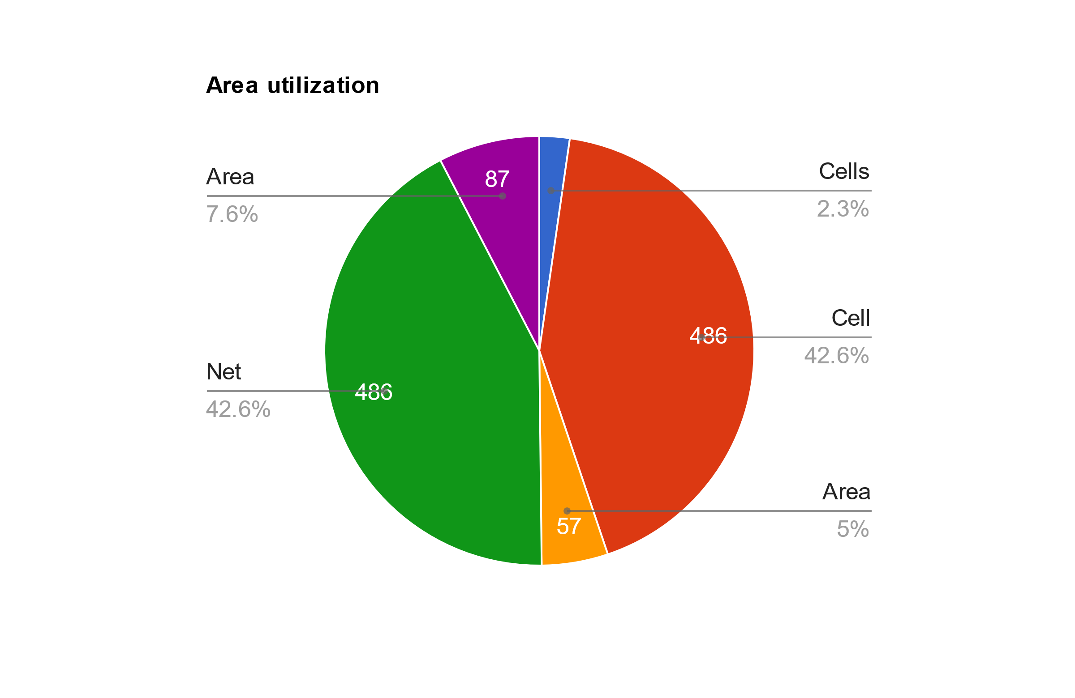
AREA UTILIZATION

Slide 69
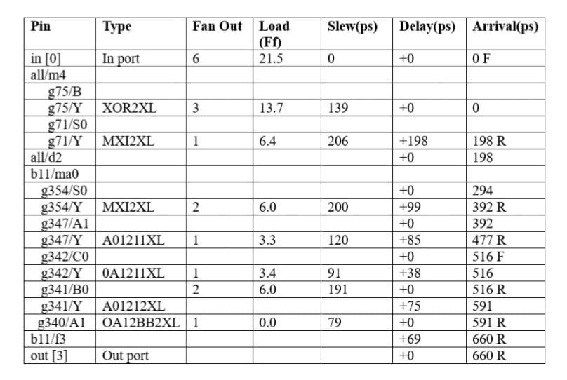
3.TIME
Timing Summary in Xilinx Design Suite.
Detailed FPGA timing analysis.
Critical path, setup/hold times, max frequency.
Ensure timing requirements.
Optimize timing closure, performance.

Slide 70
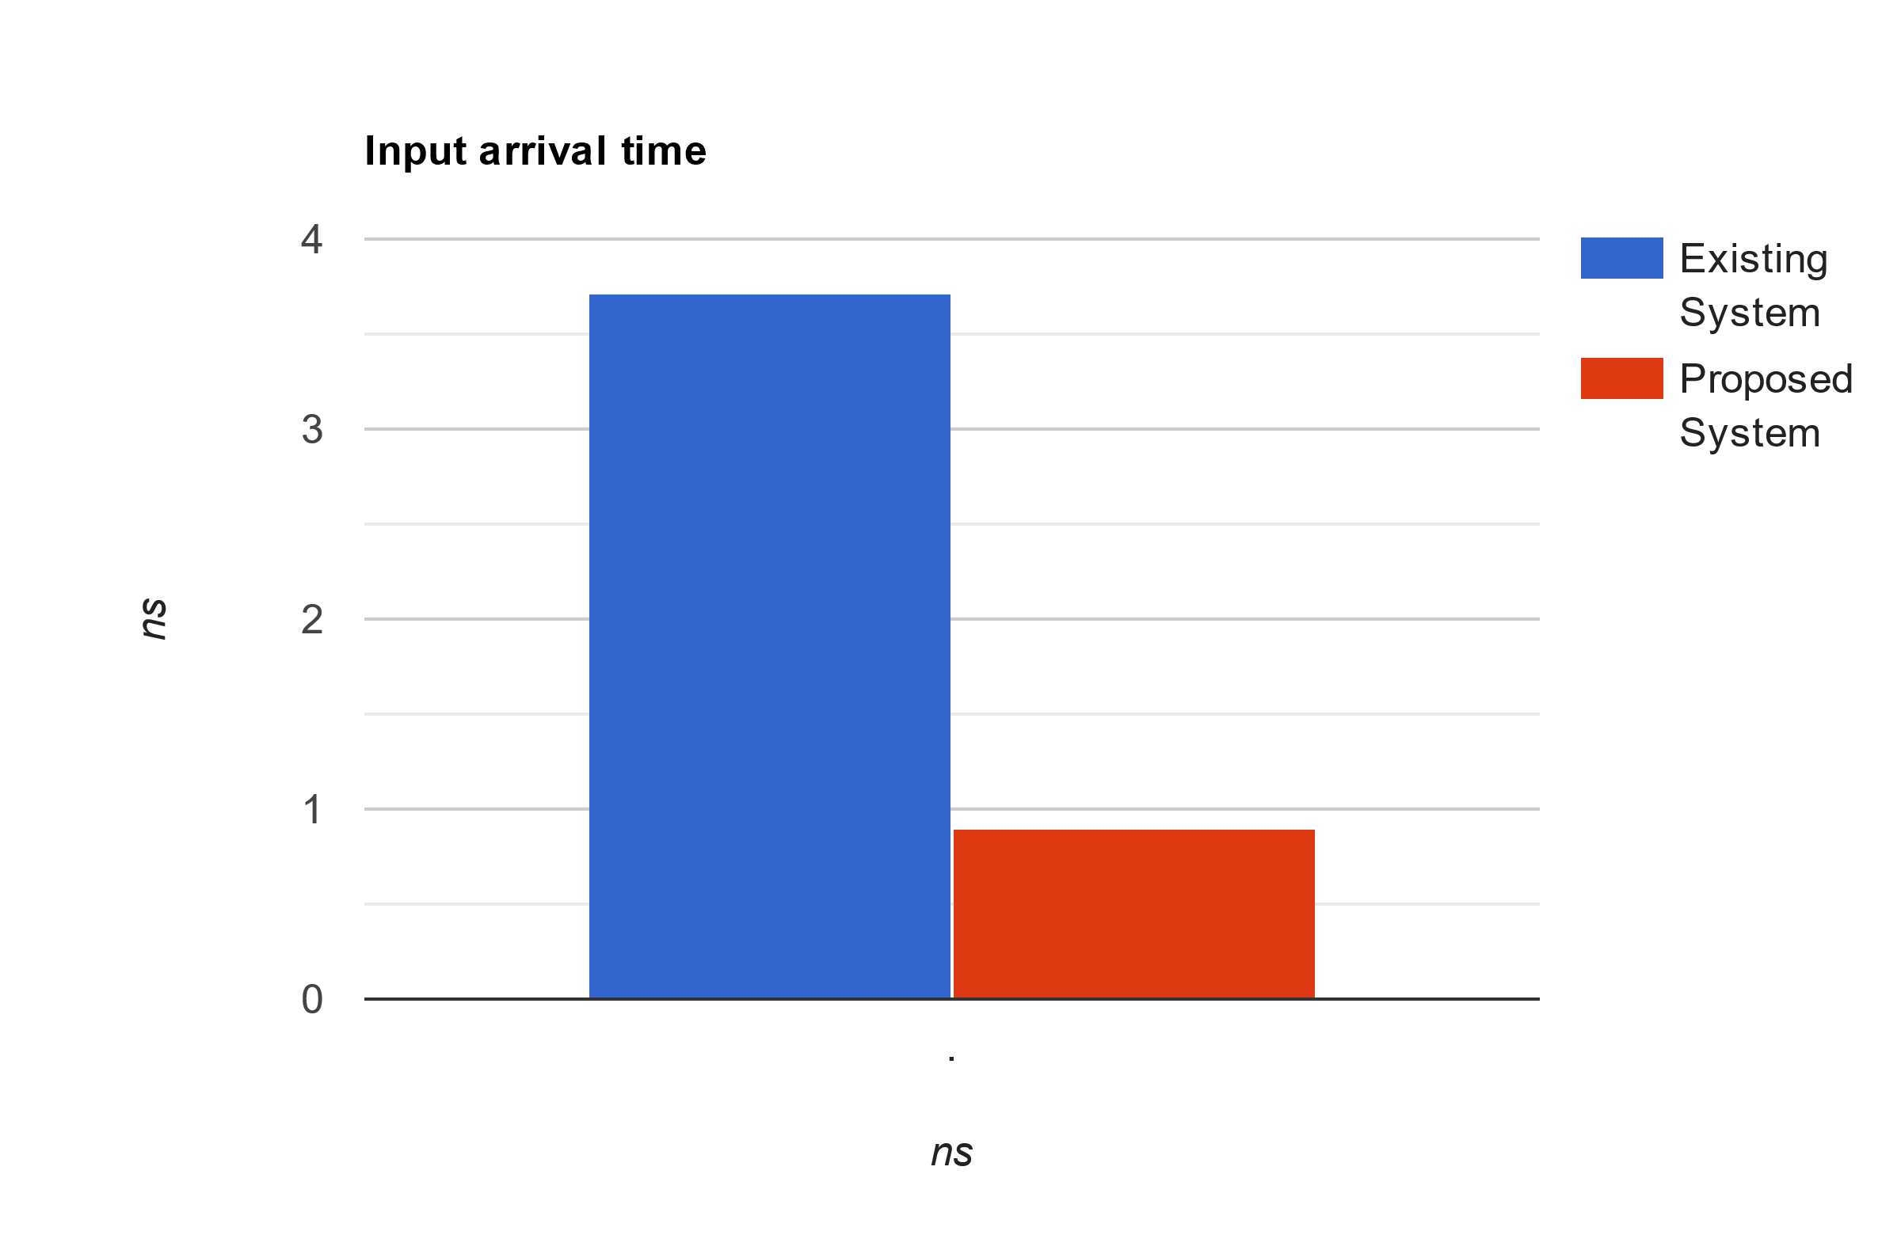
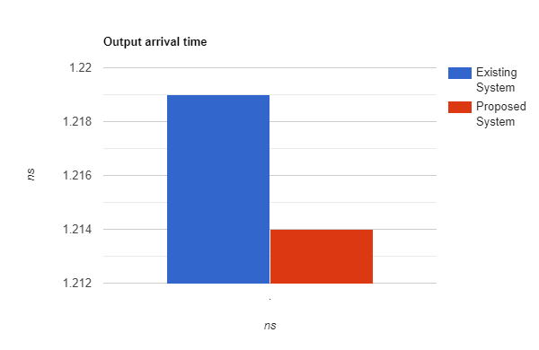
Design timing summary

Slide 71
CONCLUSION
AES algorithm when implemented is among the best encryption and decryption standards in modes of operation such as ECB, CBC, CFB, OFB. This work presents the concept and implementation of Image Encryption and Decryption using AES-128 bit to safeguard sensitive image data from unauthorized access.
It is beneficial to investigate the route for putting such an approach into practice utilizing Verilog code that is generated and simulated with the ISE in the Xilinx Family Kintex-7.The Maximum Frequency achieved from the design is 100MHz and the power consumption rate is 28007.343nw for the Image Encryption and Decryption.

Slide 72
Future Scope
Performance Optimization: Enhance encryption and decryption speed to achieve higher throughput and lower latency.
Scalability Improvements: Adapt the system for larger datasets and more complex image processing tasks.
Key Management: Integrate robust key management mechanisms to enhance security.
Additional Security Features: Implement authentication and tamper resistance to further secure encrypted data.
Wider FPGA Compatibility: Extend the implementation to other FPGA families beyond Kintex-7 for broader applicability.

Slide 73
REFERENCES
[1] Perspectives in Communication, Embedded-Systems and Signal-Processing (PiCES) – An International Journal ISSN: 2566-932X, Vol. 2, Issue 11, February 2019 © ΠCES 2018. All right reserved. Publisher: PiCES Journal, www.pices-journal.com 342 AES Based Algorithm for Image Encryption and Decryption.
[2] IMAGE ENCRYPTION AND DECRYPTION USING AES ALGORITHM Roshni Padate1, Aamna Patel2. ISSN 0976 – 6464(Print) ISSN 0976 – 6472(Online) Volume 6, Issue 1, January (2015), pp. 23-29 http://www.iaeme.com/IJECET.asp Journal Impact Factor (2014): 7.2836 www.jifactor.com,INTERNATIONAL JOURNAL OF ELECTRONICS AND COMMUNICATION ENGINEERING & TECHNOLOGY (IJECET)

Slide 74
CONT…
[3] Review on Image Encryption/Decryption using AES Algorithm for Hardware Accelerator Design and Implementation IOSR Journal of VLSI and Signal Processing (IOSR-JVSP) Volume 10, Issue 4, Ser. I (Jul. - Aug. 2020), PP 08-19 e-ISSN: 2319 – 4200, p-ISSN,No:2319–4197 www.iosrjournals.org Deeksha P1 , Suchitra M2 , Mokshith B3 , Sharath Kumar K4 , Ayaz Jaffar5
[4] Image Encryption and Decryption using AES International Journal of Engineering and Advanced Technology (IJEAT) ISSN: 2249-8958 (Online), Volume-1 Issue-5, June 2012 Manoj. B, Manjula N Harihar

Slide 75
CONT…
[5] FPGA Implementation of AES for Image Encryption and Decryption International Journal of Innovative Technology and Exploring Engineering (IJITEE) ISSN: 2278-3075, Volume-8 Issue-7 May, 2019 Vijayakumar P, Chaitanya Kumar Chittoju, A.V. Bharadwaja, Payal P. Tayade, Tamilselvi M, R. Rajashree, Xiao-Zhi Gao
[6] 2D IMAGE ENCRYPTION AND DECRYPTION USING AES ALGORITHM IN SPARTAN - 3E FPGA Chandrasekhar V1 , Ravi Babu T2 , PSN Bhaskar3 , Nihar Ranjan Panda4 M. Tech Student, Assistant professor, Assistant professor, Associate professor Dept. of Electronics &Communication Engineering, Sanketika Vidya Parishad Engineering College, Visakhapatnam, India

Slide 76


